Slide 1
Different aspects of virtual reality
Ceenu George
Prof. Florian Alt
Hauptseminar Medieninformatik SS17

Slide 2
Übersicht
Voraussetzungen:
Aktuell im Master (Medien-)Informatik / MCI
Englische Sprachkenntnisse
Forschungsthemen:
Jedes Thema wird von (max) 2 Studenten eigenständig bearbeitet
Lernziel der Veranstaltung: Wissenschaftliches Arbeiten
Selbstständige Literaturrecherche
Analyse und Einordnung von Forschungsergebnissen
Schreiben einer wissenschaftlichen Ausarbeitung
Schriftliche Ausarbeitung in Englisch (6-8 Seiten, LaTeX-Template siehe Webseite)
Abschlusspräsentation (15 Minuten + 5 Minuten Diskussion)
Webseite: www.medien.ifi.lmu.de/lehre/ss17/hs/

Slide 3
Organisatorisches
Umfang: 2 SWS / 6 ECTS-Credits
Prüfer: Prof. Dr. Florian Alt
Betreuerin: Ceenu George c.george@lmu.de

Slide 4
Organisatorisches
Präsenztermine: ausgewählte Termine, Mittwoch 12:15-14:00 Uhr
Verschiedene Abgaben lt. Zeitplan
Vorträge am Ende der Vorlesungszeit, geplant für 03. & 02.08.2017, ganztägig
Prüfungsmodalitäten
Vorläufige Ausarbeitung / kommentierte Gliederung
90-Sekunden-Vortrag (inkl. Abgabe)
Schriftliche Ausarbeitung
gegenseitige Begutachtung / Kommentierung
Überarbeitete schriftliche Ausarbeitung im vorgegebenen Format
Vortrag (zuvor Struktur, Entwurf abgeben!)
Hinweis: Die Literatur ist überwiegend nur in englischer Sprache verfügbar. Gute englische Sprachkenntnisse sind für die Teilnahme erforderlich.

Slide 5
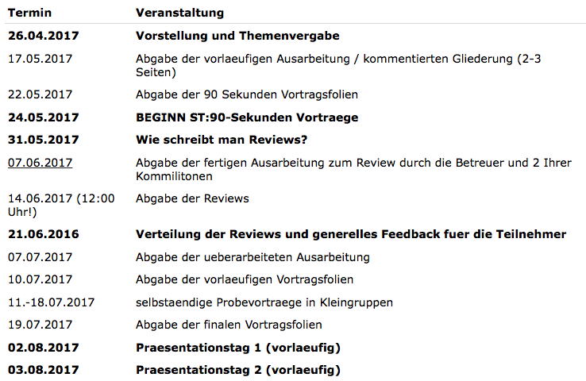
Zeitplan

Slide 6
VR/AR – Application Areas
Short Description:
What are the application areas of VR/AR? Describe how the application areas have evolved over time, considering VR is a long researched topic. Which application area is becoming important for the adaption and success of VR and what is still lacking for the technology to get more widely adapted?
References:
[1] Sherman, W.R., Craig, A.B.: Understanding Virtual Reality – Interface, Application and Design. USA: Elsevier Science, 2003. ISBN 155860-353-0.
[2] Mazuryk, T., Gervautz, M.: Virtual reality – History, Applications, Technology and Future. Vienna: Vienna Institute of Technology, Institute of Computer Graphics. Available on http://www.cg.tuwien.ac.at
[3] Foxx, J., Arena, D., Bailenson, J.N.: Virtual reality – A Survival Guide for Social Scientists. Stanford, CA, 2009. Available on http://vhil.stanford.edu
[4] http://www.vrs.org.uk/virtual-reality- applications/business.html

Slide 7
VR/AR – Input Devices
Short Description:
What technologies exist to interact with virtual reality? Provide an overview of input devices for virtual reality and what the future holds for them.
References:
Burdea, Grigore, Paul Richard, and Philippe Coiffet. "Multimodal virtual reality: Input‐output devices, system integration, and human factors." International Journal of Human‐Computer Interaction 8.1 (1996): 5-24.
Cohen, Philip, et al. "Multimodal interaction for 2D and 3D environments [virtual reality]." IEEE Computer Graphics and Applications 19.4 (1999): 10-13.

Slide 8
VR/AR –Display Technology
Short Description:
What technologies exist to enter virtual reality? First, define what types of virtual reality exist, then explore what technologies are available to immersive yourself in the different virtual realities. What differentiates the technologies from each other (advantages and disadvantages)? Provide a brief technical description of each of the technologies.
References:
[1] Sherman, W.R., Craig, A.B.: Understanding Virtual Reality – Interface, Application and Design. USA: Elsevier Science, 2003. ISBN 155860-353-0.
[2] Mazuryk, T., Gervautz, M.: Virtual reality – History, Applications, Technology and Future. Vienna: Vienna Institute of Technology, Institute of Computer Graphics. Available on http://www.cg.tuwien.ac.at

Slide 9
VR/AR –Presence and Immersion
Short Description:
Presence and Immersion are two of the key terms when measuring good virtual reality systems. What do these terms mean and why are the important tools of measurement? What sub categories of presence exist (e.g. spatial presence)?
References:
Barfield, Woodrow, et al. "Presence and performance within virtual environments." Virtual environments and advanced interface design (1995): 473-513.
Slater, Mel, and Sylvia Wilbur. "A framework for immersive virtual environments (FIVE): Speculations on the role of presence in virtual environments." Presence: Teleoperators and virtual environments 6.6 (1997): 603-616.
Ravaja, N., Laarni, J., Saari, T., Kallinen, K., Salminen, M., Holopainen, J., & Järvinen, A. (2004). Spatial presence and emotional responses to success in a video game: A psychophysiological study. Proceedings of the PRESENCE, 112-116.

Slide 10
VR – Driving Simulator
Short Description:
This topic is devoted to the humans‘ cogition and perception when driving in a VR simulator compared to the real world. What are preceptual differences; e.g. regarding perceived speed? Does it require more ressources from the driver?
References:
Kemeny, Andras. 2014. „From driving simulation to virtual reality“. In Proceedings of the 2014 Virtual Reality International Conference (VRIC '14). ACM, New York, NY, USA, 5 pages.
Kemeny, Andras. ”Driving Simulation for Virtual Testing and Perception Studies." DSC 2009. 2009.
Ihemedu-Steinke, Quinate, Erbach, Rainer, Halady, Prashanth, Meixner Errit, Weber, Michael. 2017. “Virtual Reality Driving Simulator Based on Head-Mounted Displays.” In Automotive User Interfaces. Springer Verlag, pages 401-428
Lengenfelder, J. Schultheis, M. T., Al-Shihabi, T. Mourant, R. DeLuca J. 2002. “Divided attention and driving: a pilot study using virtual reality technology.”. In Journal of Head Trauma Rehabilitation. Wolters Kluwer. pages 26-37.
Notes:
From Driving Simulation to Virtual Reality
Examining usability of a virtual reality driving simulator
A HMD BASED VIRTUAL REALITY DRIVING SIMULATOR
Divided attention and driving: a pilot study using virtual reality technology.
DRIVING SIMULATION FOR VIRTUAL TESTING AND PERCEPTION STUDIES

Slide 11
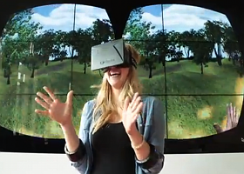
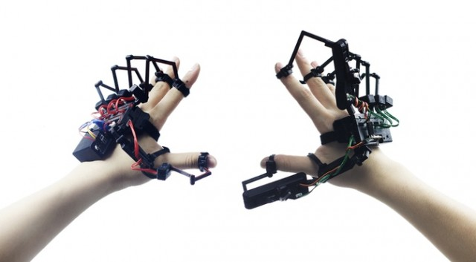
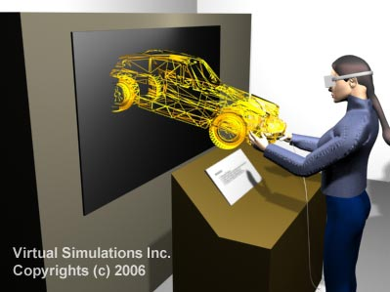
VR supporting the innovation process
Short Description:
Virtual reality creates an immersive experience, which is highly valuable in early stages of new product development, e.g. for identifying end-customer needs, to generate empathy, trigger inspiration and to enable discussion and collaboration on early prototypes.
This project takes a look into current research on VR employed within early stages of innovation: empathy-building and immersion experience within the idea generation phase, the possible integration of end-customers, collaboration on prototypes, current applications and trends, giving an outlook on possible paths for the future.
References:
Kohler, T., Fueller, J., Stieger, D., & Matzler, K. (2011). Avatar-based innovation: Consequences of the virtual co-creation experience. Computers in Human Behavior, 27(1), 160-168.
Füller, J., & Matzler, K. (2007). Virtual product experience and customer participation—A chance for customer-centred, really new products. Technovation, 27(6), 378-387.
Pappas, M., Karabatsou, V., Mavrikios, D., & Chryssolouris, G. (2006). Development of a web-based collaboration platform for manufacturing product and process design evaluation using virtual reality techniques. International Journal of Computer Integrated Manufacturing, 19(8), 805-814.
Note: Image on Top: Dexmo F2 Exoskeleton

Slide 12

Evaluating Perceived Control and Authorship in Virtual Reality
Short Description:
Perceived control and authorship are a recurring schemes with many facets in HCI. Evaluating these is non-trivial and thus multiple approaches towards it exist. Your paper should summarize existing approaches and discuss how these can exploited for use in virtual reality environments.
References:
A. Hoesl, P. A. Vu, C. Rosenmöller, F. Lehmann, and A. Butz, “Towards an Evaluation Framework: Implicit Evaluation of Sense of Agency in a Creative Continuous Control Task,” in Proceedings of the 35th Annual ACM Conference Extended Abstracts on Human Factors in Computing Systems, Denver, Colorado, USA, 2017.
A. Hoesl and A. Butz, “Sense of Authorship and Agency in Computational Creativity Support,” in Proceedings of the Workshop on Mixed-Initiative Creative Interfaces (MICI’17) in conjunction with CHI’17, Denver, Colorado, USA, 2017.
P. J. Hinds, “User Control and Its Many Facets: A Study of Perceived Control in Human-Computer Interaction,” Hewlett Packard Laboratories, 1998.

Slide 13
User-centered Evaluation of Personalized Systems for VR
Short Description:
Personalized systems are pervasive in daily use and personalization is an active research area. In this project, we want to gain an overview of how researchers evaluate their work in user studies. In particular, we are interested in the methodology used (e.g., surveys, interviews), the number and demographics of participants, the variables assessed (e.g., usability, trust), the analysis (qualitative or quantitative) and the kind of systems that are presented. Thus, we want to identify best practices for user-centered evaluation of personalized systems.
References:
Van Velsen, L., Van Der Geest, T., Klaassen, R., & Steehouder, M. (2008). User-Centered Evaluation of Adaptive and Adaptable Systems: A Literature Review. The Knowledge Engineering Review, 23(03), 261-281.

Slide 14

WebVR – Past, Present, Future
Short Description:
Technologies like VRML and X3D have existed for years. They
intended to open Browsers for Virtual Reality. However, they
have never gained widespread adoption.
With Browsers finally offering VR APIs, the tables are turning. This project takes a look into the history of VR for the web, current applications and trends, as well as an outlook to future developments.
References:
Zhang, M., Lv, Z., Zhang, X., Chen, G., & Zhang, K. (2009). Research and Application of the 3D Virtual Community Based on WEBVR and RIA. Computer and Information Science, 2(1), 84.
Neelakantam, S., & Pant, T. (2017). Setting Up Your VR Lab and Popular WebVR Projects. In Learning Web-based Virtual Reality (pp. 11-16). Apress.
Koročsec, D., Holobar, A., Divjak, M., & Zazula, D. (2005). Building interactive virtual environments for simulated training in medicine using VRML and Java/JavaScript. Computer Methods and Programs in Biomedicine, 80, S61-S70.

Slide 15
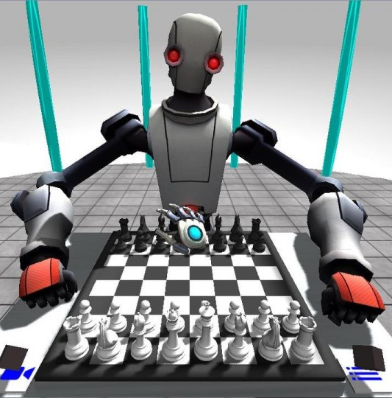
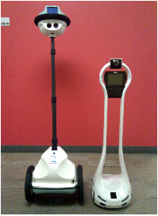
Robots & VR
Short Description:
The topic covers the synergy between virtual reality and the field of human-robot-interaction (HRI).
Main focus: The impact of avatars and remote operation. Investigation and presentation of current and future applications (e.g., collaboration, telepresence, medical applications).
References:
Burdea, G. C. (1999). Invited review: the synergy between virtual reality and robotics. IEEE Transactions on Robotics and Automation, 15(3), 400-410.
Monferrer, A., & Bonyuet, D. (2002). Cooperative robot teleoperation through virtual reality interfaces. In Information Visualisation, 2002. Proceedings. Sixth International Conference on (pp. 243-248). IEEE.
Thellman, S., Silvervarg, A., Gulz, A., & Ziemke, T. (2016, September). Physical vs. Virtual Agent Embodiment and Effects on Social Interaction. In International Conference on Intelligent Virtual Agents (pp. 412-415). Springer International Publishing.
Artstein, R., Traum, D., Boberg, J., Gainer, A., Gratch, J., Johnson, E., ... & Nakano, M. (2016, October). Niki and Julie: a robot and virtual human for studying multimodal social interaction. In Proceedings of the 18th ACM International Conference on Multimodal Interaction (pp. 402-403). ACM.

Slide 16
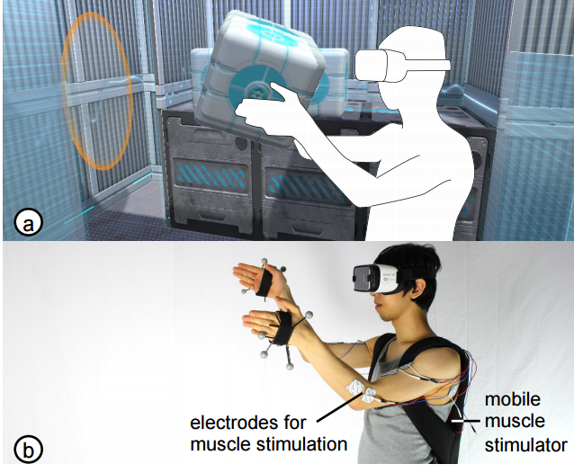
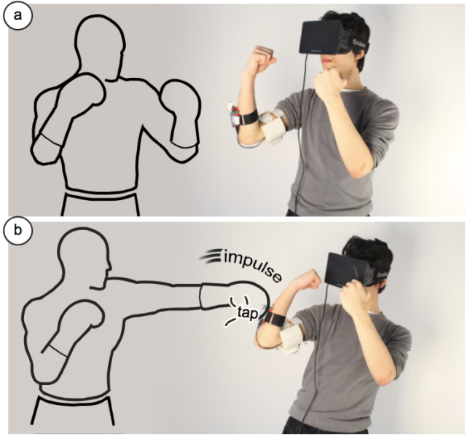
Electric Muscle Stimulation in VR
Short Description:
Electric muscle stimulation (EMS) have had several interesting applications recently. For example, it was proposed for steering pedestrians away from danger as they walk in streets. EMS has even more exciting applications in VR (examples below). The goal of this work is to research (1) what advantages and drawbacks does EMS have in VR compared to other feedback modalities (e.g., haptic feedback), (2) what are research and industry applications of EMS in VR?
References:
EMS in VR
Lopes, P., Young, S., Cheng, L., Marwecki, S., and Baudisch, P. Providing Haptics to Walls and Other Heavy Objects in Virtual Reality by Means of Electrical Muscle Stimulation. In Proceedings of CHI'17 (paper) (video)
Lopes, P., Ion, A., Baudisch, P. Impacto: Simulating Physical Impact by Combining Tactile Stimulation with Electrical Muscle Stimulation. In Proc. UIST'15. pp. 11-19. (project page | paper | video) (talk)
Pfeiffer, M., Schneegass, S., Alt, F., & Rohs, M. (2014, March). Let me grab this: A comparison of ems and vibration for haptic feedback in free-hand interaction. In Proceedings of the 5th augmented human international conference (p. 48). ACM. (paper) (video)
EMS in general
Hassan, M., Daiber, F., Wiehr, F., Kosmalla, F., & Krüger, A. (2017). FootStriker: An EMS-based Foot Strike Assistant for Running. Proceedings of the ACM on Interactive, Mobile, Wearable and Ubiquitous Technologies, 1(1), 2. Chicago (paper)
Pfeiffer, M., Dünte, T., Schneegass, S., Alt, F., & Rohs, M. (2015, April). Cruise control for pedestrians: Controlling walking direction using electrical muscle stimulation. In Proceedings of the 33rd Annual ACM Conference on Human Factors in Computing Systems (pp. 2505-2514). ACM. (paper) (video) (talk)

Slide 17
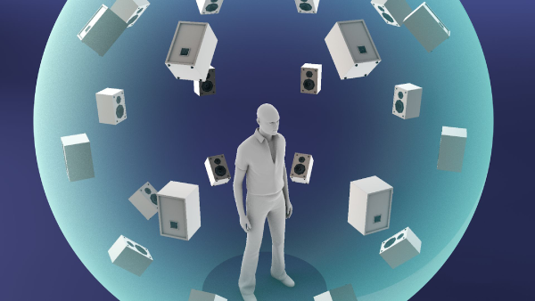
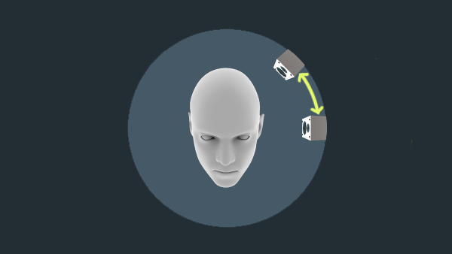
VR – Spatial Sound
Short Description:
Spatial Audio is important for good VR experience. It supports the illusion of being in another. It could be a powerful tool for guiding user attention. With sounds from a certain direction you can give him cues on where to look next.
References:
Begault, D. R. and Trejo, L. J. (2000). 3-d sound for virtual reality and multimedia.
Poeschl, S., Wall, K., and Doering, N. (2013). Integration of spatial sound in immersive virtual environments an experimental study on effects of spatial spatial sound on presence. In Virtual Reality (VR), 2013 IEEE, pages 129–130. IEEE.
Jordan, D., Müller, F., Drude, C., Reinhold, S., Schomakers, V., and Teistler, M. (2016). Spatial audio engineering in a virtual reality environment. Mensch und Computer 2016-Tagungsband

Slide 18
VR/AR –Motion / Simulator sickness
Short Description:
Explore what factors influence motion sickness when experiencing virtual reality. How is motion sickness measured and is motion sickness the same for everyone and every virtual reality device?
References:
McCauley, Michael E., and Thomas J. Sharkey. "Cybersickness: Perception of self-motion in virtual environments." Presence: Teleoperators & Virtual Environments 1.3 (1992): 311-318.

Slide 19
VR/AR – Agent Representation
Short Description:
There are multiple ways to present the player and others in virtual reality. Provide an overview of what these options are and what to watch out for when for example creating an avatar. To what extent can aspects of human interaction be transferred to a VR agent?
References:
Young, Mary K., John J. Rieser, and Bobby Bodenheimer. "Dyadic interactions with avatars in immersive virtual environments: high fiving." Proceedings of the ACM SIGGRAPH Symposium on Applied Perception. ACM, 2015.
Slater, Mel, and Maria V. Sanchez-Vives. "Transcending the self in immersive virtual reality." Computer 47.7 (2014): 24-30.

